Slide 1

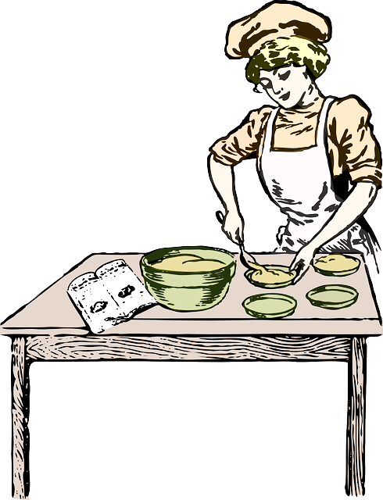

THE BAKERY
ℱ1000

Slide 2





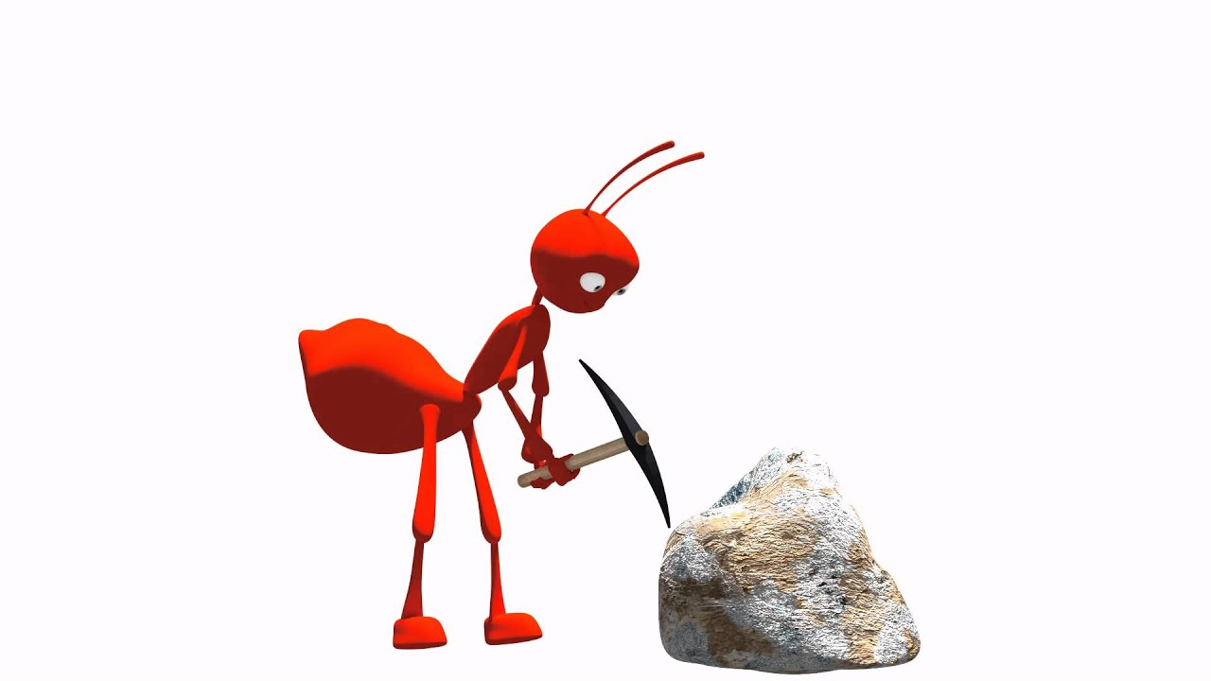





?
This Photo by Unknown Author is licensed under CC BY
This Photo by Unknown Author is licensed under CC BY
PUDDING
KING

Slide 3









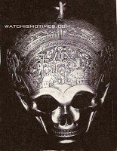

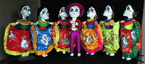



This Photo by Unknown Author is licensed under CC BY-NC-ND
This Photo by Unknown Author is licensed under CC BY-SA
This Photo by Unknown Author is licensed under CC BY-SA
This Photo by Unknown Author is licensed under CC BY
This Photo by Unknown Author is licensed under CC BY

Slide 4


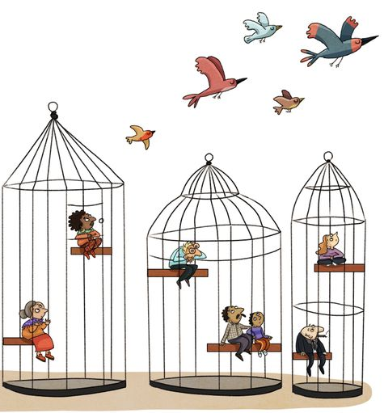

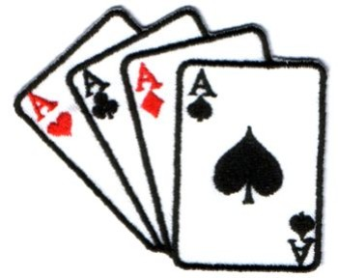


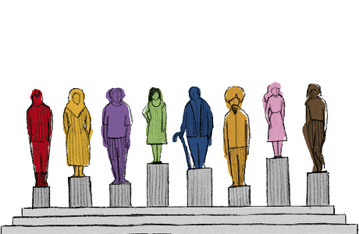
This Photo by Unknown Author is licensed under CC BY-NC

